Slide 1
Expanding HIV Prevention with telehealth
Rob Stephenson, PhD
Professor
Systems, Population and Leadership
School of Nursing
Center for Sexuality and Health Disparities
University of Michigan
rbsteph@umich.edu

Slide 2
HIV in the U.S.
MSM bear a disproportionate burden of HIV infection
Troubling trends
HIV incidence is increasing among MSM, particularly among young MSM and MSM of color
The practice of UAI appears to be increasing among MSM in the U.S.
Focus is largely on individual risk factors
MSM, in particular gay men, are often seen as individuals at risk of infection – absent of consideration of their lives and relationships
Diagnoses of new HIV infection among adolescents and adults in the United States, 2011

Slide 3
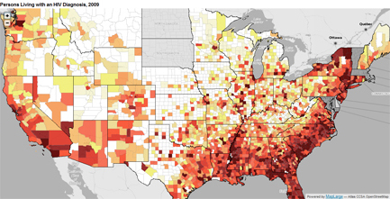
HIV in the U.S. Non-random patterns of HIV infection

Slide 4
HIV among MSM: A Syndemic Theory
HIV
Mental Health
Internalized Homophobia
Childhood Sexual Abuse
Substance/ Alcohol Abuse
Tobacco Use
STIs
Hate Crimes/ Homophobia
Intimate Partner Violence
Notes:
So great to be at AIDS because we get to talk about contextual, situational factors that put people at increased risk of HIV.
In MSM, this is call the theory of syndemics – multiple concurrent epidemics
Until very recently, IPV in same-sex couples has been ignored

Slide 5
Defining stigma
How do we define stigma?
What are the first words that come to mind when we think of stigma?

Slide 6
Defining stigma
Link and Phelan (2001, pg. 367), expand Goffman’s seminal work (Notes on a Spoiled Identity, 1963) further by developing four processes of stigma:
1) “human differences are labeled by others;
2) dominant culture stereotypes these labels;
3) categories of labels separate the labeled group from larger society; and
4) status loss and discrimination leads to unequal outcomes.”

Slide 7
Types of stigma
Enacted Stigma
Internalized Stigma
Anticipated Stigma
Negative reactions to stigma, especially in social settings” and
“episodes of discrimination experienced by those with the stigmatizing attribute”
Saewyc, E. M., Poon, C. S., Homma, Y., & Skay, C. L. (2008); Lekas, H. M., Siegel, K., & Leider, J. (2011)
“self-directed prejudice in response to adapting one’s self-concept to be congruent with stigmatizing responses by society”
Herek, Gillis, & Cogan, 2009
“The degree to which individuals expect that others will stigmatize them in various settings”
Quinn & Chaudoir, 2009

Slide 8
Types of stigma
Concealable Stigma
Associative Stigma
“A stigma that can be kept hidden from others but carries with it a social devaluation”
Quinn & Chaudoir, 2009
“A stigma due to association (typically a caregiver, sibling, parent, partner, friend) of someone who carries a concealable stigmatized identity.”
Quinn & Chaudoir, 2009

Slide 9
Components of Stigma
Centrality
Salience

Slide 10
Minority Stress theory
Illan Meyer(1995, 2003), UCLA’s Williams Institute
Combines stress theory (Lazarus and Folkman, 1984), social psychological theories, and social stress theories to understand both chronic and recent stress experiences of LGB people.
Minority stress theory incorporates “(a) external, objective stressful events and conditions, (b) expectations of such events and the vigilance this expectation requires, and (c) the internalization of negative societal attitudes” (Meyer, 2003).

Slide 11
How does stigma shape health?
Prevents access to services
Shapes the views of service providers
Prevents people from asking for health
Creates stress response behaviors
Substance use
Sexual risk taking
Lower sense of self worth

Slide 12
Video-based counseling for home HIV testing
FDA approved home-based HIV testing July 2012
Concerns remain over lack of counseling
Couples test less frequently than single men
Can we increase the impact of home-based HIV testing by remote operated video-based counseling for male-male couples?

Slide 13
Reaching remote couples and improving counseling for home-based testing
Current Standard of Care
Research Intervention
Home test(s)
Home test(s)
+
Video conference with a trained CHTC counselor
Interpret results
Assistance interpreting results
Facilitated sharing of results and post-test counseling
Does adding a Skype-based counseling session to home-based testing improve relationship and care outcomes?
Linkage to care

Slide 14
Reaching remote couples and improving counseling for home-based testing
Current Standard of Care
Research Intervention
Main Outcomes Relationship functioning
Sexual Agreements Sexual behaviors
Linkage to Care
Secondary Outcomes Cost-effectiveness

Slide 15
Transgender People & HIV Risk
In 2015, trans identified people received new HIV diagnoses more than 3 times the national average
Notes:
Narrative structure:
Give an overview of feasibility
-- recent data, trans (not just youth) diagnoses
---

Slide 16
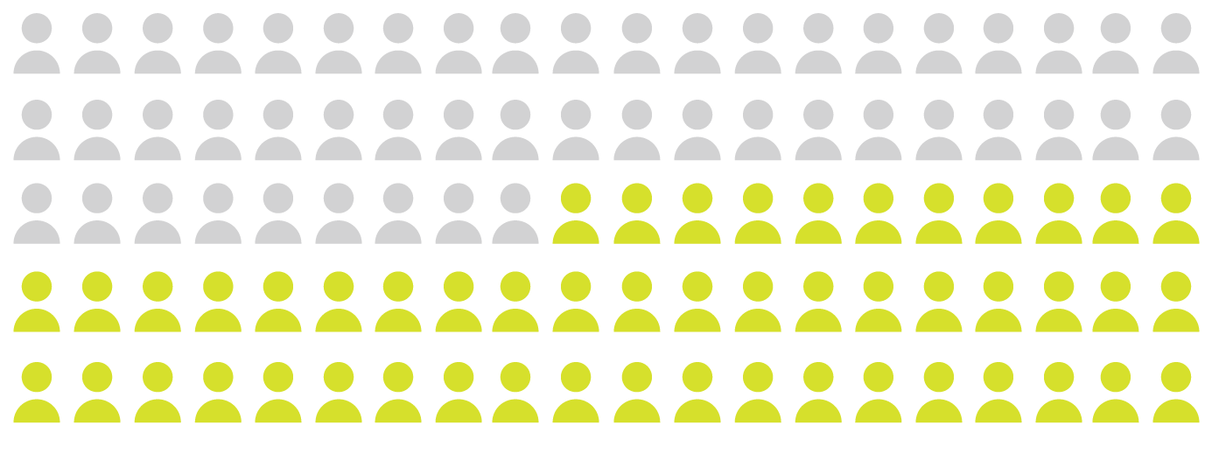
Young People & HIV Risk
In 2015, an estimated 60,300 youth were living with HIV and an estimated 51% (31,000) were living with undiagnosed HIV
Notes:
Increasing youth epidemic,
(continue to add to the narrative)
What we don’t know the HIV incidence or prevalence of TY
It follows that TY would be higher than cisgender youth

Slide 17
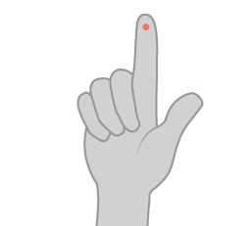
Screening & Prevention Behavior
HIV Testing
Condomless Sex
Notes:
We do know that testing
TY are testing at lower rates, and are partaking in riskier sex behaviors than their cisgender-LGB peers.

Slide 18
At-home Testing & Concerns
Understanding Results
Prevention Promotion
Linkage to Care
Notes:
Wuick in and out slide, home tests are great however
3 potential issues
Central to the intervention
At home-testing
Provide more detail for each bit,
As you may know the home-testing model can account for various barriers for marginalized populations encounter in regards to HIV prevention
Stigma
Internal transphobia
Fear of discrimination
But we also need to acknowledge how the home testing model in itself may not lead to the best outcomes.
In this intervention we wanted to ensure that TY understood their results
That alongside testing, we promoted prevention methods in our remote counseling session, as one would with an in-person test
Further, linking to care was a key component in the design of the intervention.

Slide 19
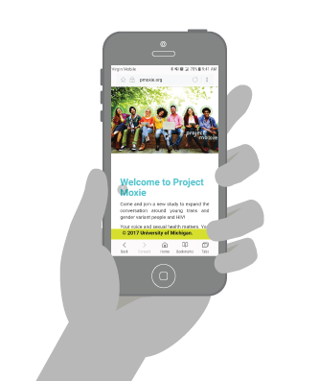
Moxie Intervention
Combining At-home HIV Testing & Remote Counseling
Notes:
Send kit, watch video chat, test, watch and counsel
Give them counseling in their own home via video chat service
All they needed was internet and connection
Our solution was to provide
Actualy give the deets on MOxie
By combining the home testing model, with the telehealth component, the Moxie intervention provided TY with an at-home testing experience, coupled with the experience of testing alongside a certified testing counselor.
Youth could access the counseling session from a mobile App, or from their browser, on a HIPPA-secure platform.

Slide 20
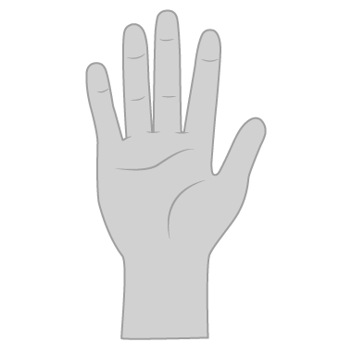
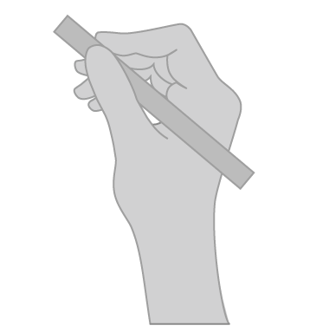
Motivational Interviewing
Enhancing Motivation
Building
Skills
Goal
Setting
Notes:
Use principles of MI

Slide 21
Study Design
Pilot RCT
Control: HIV test kit
Intervention: HIV test kit + counseling
Eligibility
[1] 15-24
[2] unknown or negative HIV status
[3]Not tested in last 6 months
[4] willing to be mailed HIV test kit
[5] U.S resident
[6] non-cisgender
[7] internet /video capability
Surveys
Baseline, 3 and 6 Months
(HIV testing, sexual behavior, linkage to care)
Notes:
Simplify it. So not too word
Narrative for surveys
-- point of this was to look at feasibility

Slide 22
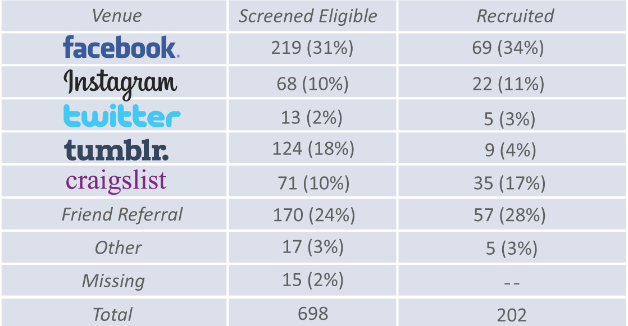
Recruitment

Slide 23
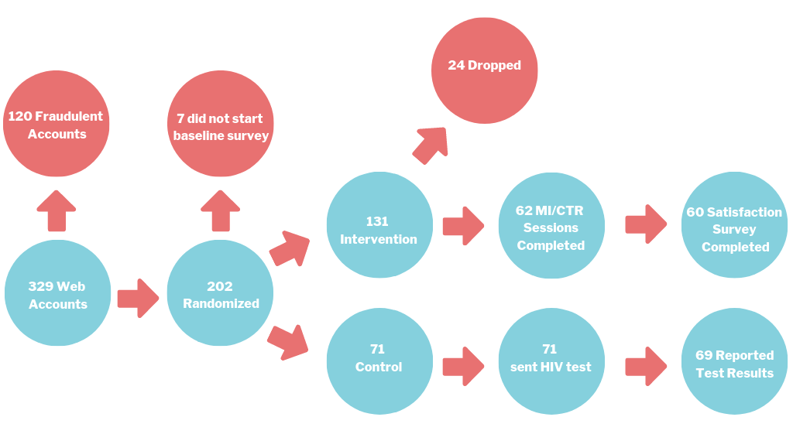
Moxie Flow Chart
Notes:
Check with Michael on numbers
Remove text that is not needed
Still remove “completed”

Slide 24
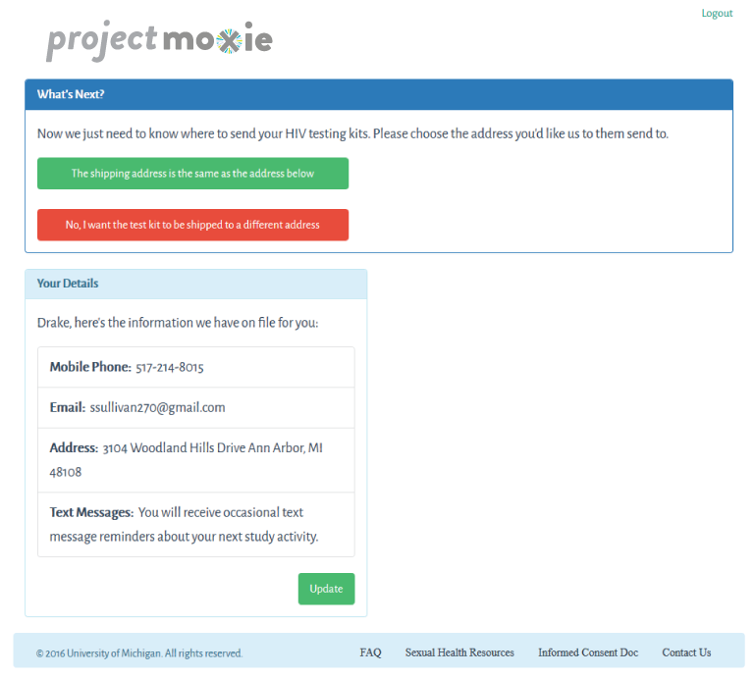
Ordering Test Kits
Notes:
Upon being enrolled in the study, participants created accounts on a website that we created alongside of developers.
We had they name address, screener questions they answered, as well as reports from their test results.
The first task for these youth, beyond the baseline survey, was to order the test kit (both arms)

Slide 25
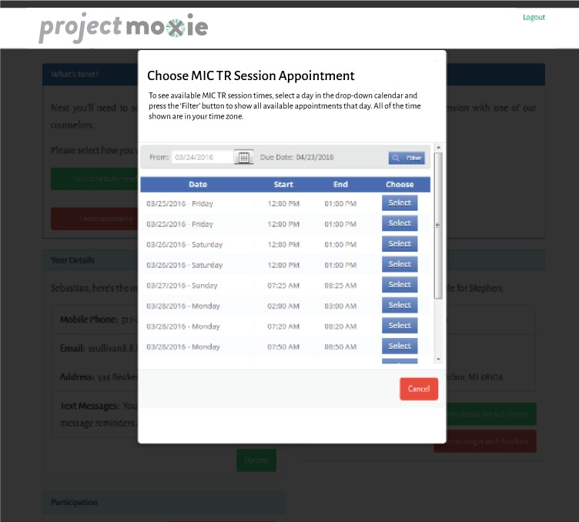
Scheduling Test Sessions
Notes:
For folks in the intervention arm, this screen was followed by a list of appointments available to them to make with our testing counselor.

Slide 26
Conducting Test Sessions
Notes:
Test counselor would report a case report form
-- after each session was completed, the counselor used
While the test was cooking, MI
Results
Post Test Counseling
*Participant enters waiting room
* Initiate Vsee Call 12674

Slide 27
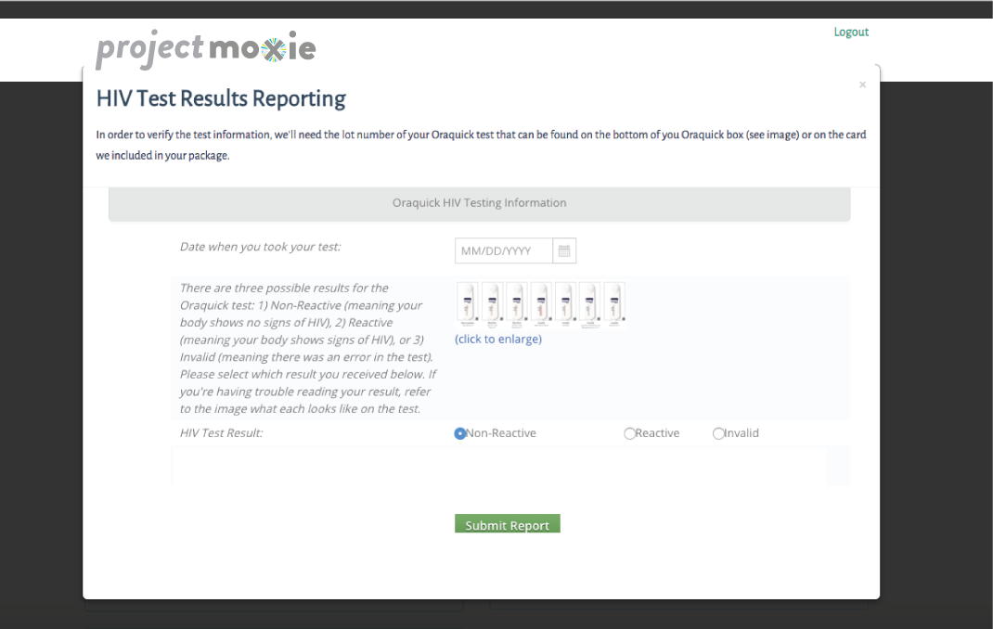
Test Results & Linkage to Care
Notes:
Only the control group entered results, we entered intervention results

Slide 28
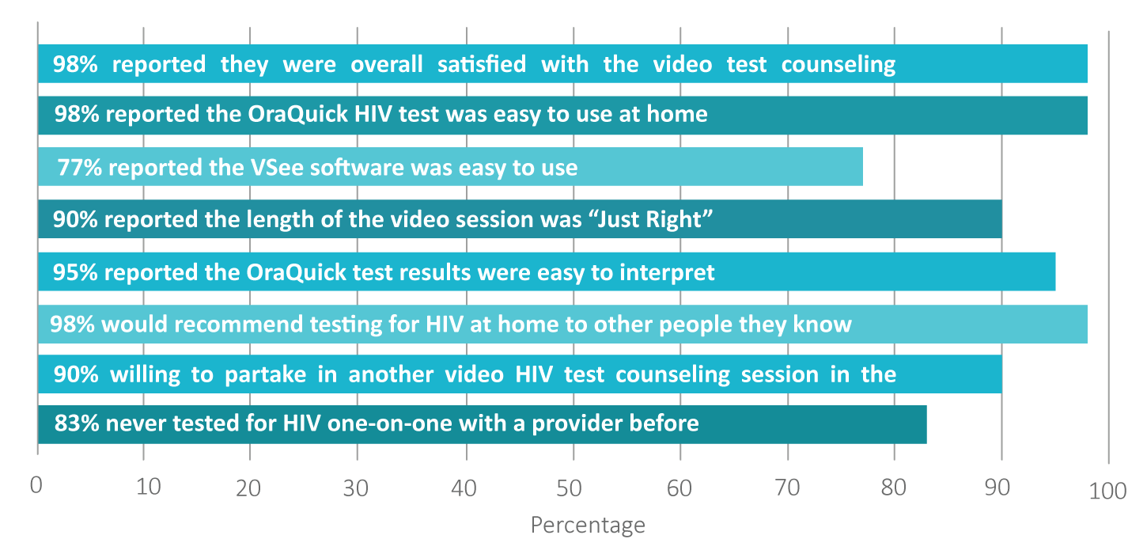
Results: Satisfaction with Intervention (N=60)
Notes:
98% reported high overall satisfaction with the video test counseling, would recommend this style of testing to people they know, and thought that OraQuick HIV Test was easy to use
Interpreting the OraQuick result was easy
Most were willing to test in this way again
And we found that 83% had never tested for HIV one-on-one with a provider before

Slide 29
Discussion
Success with building rapport and enhancing motivation among trans youth
No technical or logistical barriers to delivering the intervention
High levels of satisfaction and willingness to repeat intervention
Notes:
Drop fraud

Slide 30
The role of substance use
Evidence that male couples use substances (ATOD) together and high levels of substance use among transgender populations
ATOD use is a trigger of IPV and a stress-response behavior to IPV
Links to HIV:
ATOD triggers IPV – physical trauma – transmission
IPV creates stress – ATOD – risk taking – transmission
Perpetrators are more likely to be substance users
We too often focus on substance use behaviors and forge the triggers – IPV as a substance use reduction strategy?

Slide 31
Bringing all this together
We clearly need innovative ways to increase access to HIV prevention and STI testing
Telehealth is inexpensive and scalable
Most of all – people like it and will do it!
A feasible method for reaching groups who – for various structural and interpersonal reasons – are not testing
We need innovative ways to FIGHT stigma as a root cause of substance use and HIV risk

